Slide 1

Capstone Project
World Bank Global Education Analysis (Exploratory data analysis)
By- Gunesh Kumbhare

Slide 2
Content
Introduction
Data Pipeline
Exploring Dataset
Attribute Information
Problem Statement
Data Cleaning and Handling
Data Visualization
Key Insights
Conclusion/Recommendations

Slide 3

Introduction
The World Bank Ed Stats All Indicator Query holds over 4,000 internationally comparable indicators that describe education access, progression, completion, literacy, teachers, population, expenditures and many such indicators .The indicators cover the education cycle from pre- primary to vocational and tertiary education and also holds learning outcome data from international and regional learning assessments, equity data from household surveys, and projection/attainment data.
I am exploring and analyzing the data to identify variation of indicators across the globe, which countries are more alike and different, which countries show more closeness to global standards and what are the actual driving force behind such growth.
●

Slide 4


































Data Pipeline
Data Cleaning and Handling
Importing
Libraries
Loading the
Dataset
Exploring the
Dataset
Finding
Insights
Data
Visualization
Data
Wrangling
Conclusion

Slide 5
Exploring Dataset
The World Bank have beautifully arranged the Ed stats dataset with the help of other four subsidiary datasets . So basically there were five files.
One of them was defining the countries and their basic information like the nature of their economy, their census year , any kind of special notes and many more.
Special Notes are describing some extra information about the countries. E.g for Arab World and East Asia Pacific.
Other file was defining the indicators, on which World Bank has studied the
241 countries. It also contains, there short and long definition.
Indicator is basically the head, on which a specific educational trend have been monitored. for e.g the average attendance rate of schools of a particular country.
Short and Long definition gives the brief idea about the Indicator. For.eg Mean years of schooling would be defined as minimum no. of schooling years , people received in a country.

Slide 6
Exploring Dataset
In indicator file ,World Bank have studied 3666 indicators over 241 countries giving there trends from 1970 to present years.
The Data frame is full of null values and devoid of duplicate values.
In the Ed Stats Dataset there are near about 9,00,000 rows and 70 columns.
The Country Name , Country Code , Indicator Name and Indicator code has
‘object’ as their type.
The Year Columns(1970-2100) has the float as their Dtype

Slide 7
Attribute Information
Country Name : The name of the countries. E.g India.
Country Code: Abbreviation of countries. E.g IND for India
Indicator Name : The head on which trends have observed. E.g
Unemployment
Indicator Code: Abbreviation to show long indicator name in short. E.g
Unemployment : SL.UEM.TOTL.ZS
Years : From 1970 to 2100, the individual year is a column

Slide 8
Problem Statement
First Level of Analysis
In the first level of analysis, we selected seven indicators out of 3666 indicators to analysis the trends and data.
After that we selected the countries on which we have to work .
After selecting the countries, we extracted the data of all the seven indicators of each country.
Then selecting the countries and extracting the data of all countries

Slide 9
Problem Statement
Second Level of Analysis
1. In second level of analysis we separate the different indicators and make a separate variable to each indicators.
2. After creating a separate variable,we store the same indicators data of each country in the same variable so that we can find out or analyze which country has done a good job on which indicator.
3. By doing this, we have stored the data of all the seven indicators in seven different variables.
Third Level of Analysis
1. Just compare all the indicators of every country in one frame.
2. In this section a basic trend follow through would be performed basically we extract the data of different countries with same seven indicators so we can compare them to each other to improve the education quality

Slide 10
Cleaning and Handling Dataset
Country Name, Indicator Name, Country Code and Indicator Code column are
wholly filled, without any null values with object type of characters.
Columns from 1970 to 2100 are mostly empty and null. All these null values are filled with zeros.
The filled values from 1970 to 2100 are float type.
For Comparing the trends of LSC of four countries, I have used the values as the
size of dots in scatter plot. For that the values have been converted to ‘INTEGER’ type from ‘float’.

Slide 11
Cleaning and Handling Dataset
There are no duplicate columns.
EdSats dataset is full of null values. These null values can not be dropped directly as we have to show the yearly trends.
If these Years are dropped ,the column year would not be preset in the comparison dataframe, making it difficult to track the correct trends.
Hence I have opted to replace these null values by zero.
This representation of zero, would suggest countries to look for the correct data.
Later on When I need to find out the mean of newly formed desired data frames, I replaced those zeros back with their respective null values . So that the mean should not be affected.

Slide 12
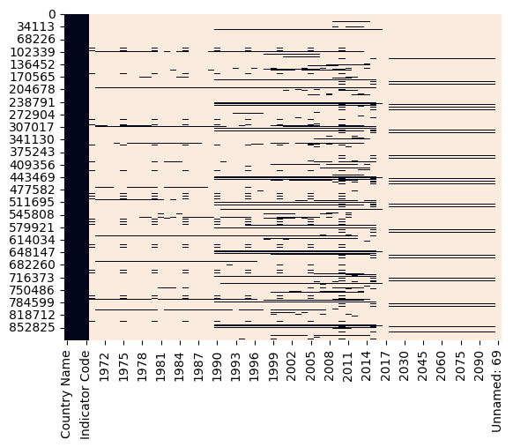
Data Visualization
First Level Analysis
World Bank education dataset was full of null values and devoid of relevant information on specific indicators. So the help arrives from heatmap to understand which columns are lacking in some specific trends. The black colour shows the absence of data in the respective columns

Slide 13
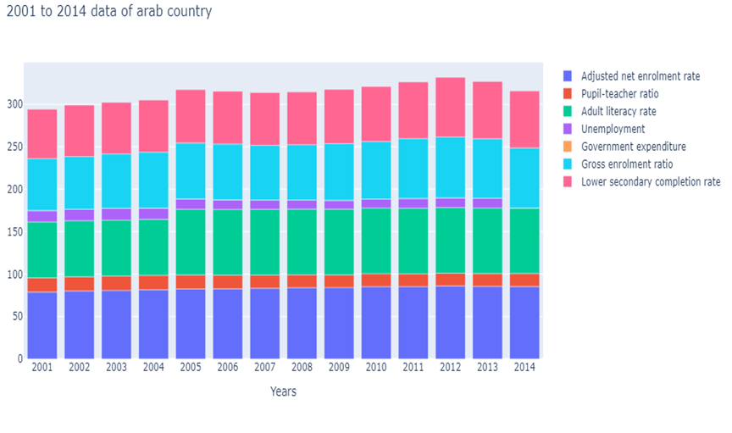
Data Visualization (First Level Analysis)
Unemployment, total (% of total labor force): The unemployment rate shows a gradual decrease from 2001 to 2010, reaching its lowest point at 10.4%. However, the rate slightly increases in subsequent years, reaching 11.4% in 2013.
Government expenditure on education as % of GDP (%): The dataset shows a value of 0.0% for government expenditure on education as a percentage of GDP throughout all the years, which seems unusual. It's possible that this data is missing or unavailable.
Gross enrolment ratio, secondary, both sexes (%): The gross enrolment ratio for secondary education shows an increasing trend over the years, starting from 61.2% in 2001 and reaching 71.7% in 2012.
Lower secondary completion rate, both sexes (%): The lower secondary completion rate displays a gradual increase from 58.3% in 2001 to 70.3% in 2014.
Adjusted Net Enrolment Rate, Primary: Over the years, the adjusted net enrolment rate for primary education has steadily increased, reaching an impressive 85.32% in 2014. This indicates a positive trend in access to primary education for both sexes.
Pupil-Teacher Ratio in Secondary Education: The pupil-teacher ratio in secondary education has remained relatively stable, with minor fluctuations. This suggests that efforts to maintain an optimal learning environment have been in place.
Adult Literacy Rate:The adult literacy rate for both sexes has seen steady improvement, reaching 77.36% consistently from 2005 onwards. This is a promising sign of progress in empowering the adult population through education.

Slide 14
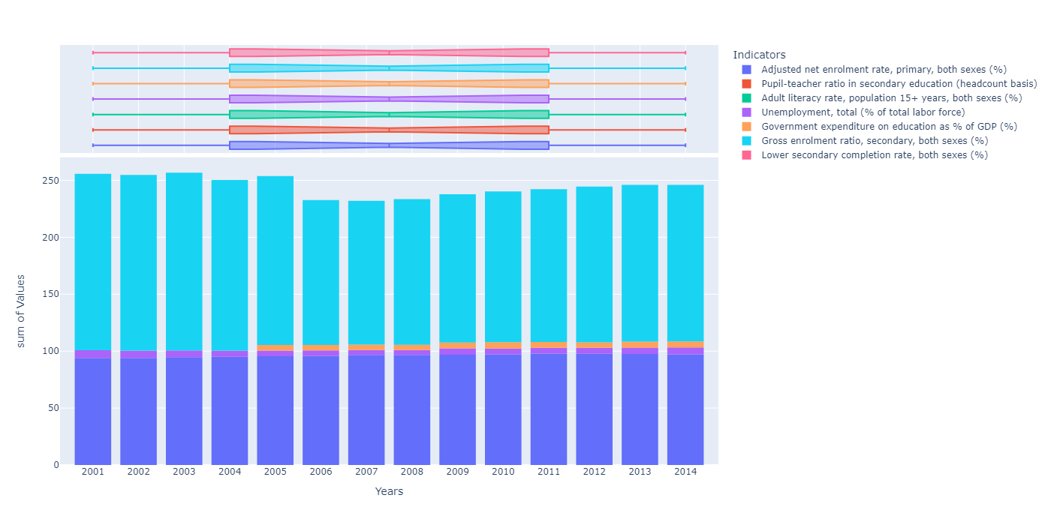
Data Visualization
Problem Statement 1: extract the data of all the seven indicators of Australia and store in one variable
consistent value of 0.0% for government expenditure on education as a percentage of GDP throughout all the years. This indicates a potential lack of investment in the education sector, which may have implications for the quality of education and long-term development.
Gross enrolment ratio, secondary, both sexes (%): The gross enrolment ratio for secondary education is relatively high, ranging from 127.4% to 156.2%. The values above 100% suggest that there may be students enrolled in secondary education beyond the typical age range.
Lower secondary completion rate, both sexes (%): The dataset contains no values for the lower secondary completion rate, with all values recorded as 0.0%. This missing data makes it challenging to assess the completion rate for lower secondary education.
Adjusted net enrolment rate, primary, both sexes (%): The primary education enrolment rate is consistently high, with values ranging from 94.0% to 97.8%. This indicates a relatively successful effort in ensuring access to primary education for both genders.
Unemployment, total (% of total labor force): The unemployment rate shows a generally decreasing trend from 6.7% in 2001 to 5.1% in 2011. However, it increases slightly to 6.1% in 2014. This suggests overall stability in the labor market, with a slight increase in unemployment towards the end of the period.
Government expenditure on education as % of GDP (%): The dataset shows a

Slide 15
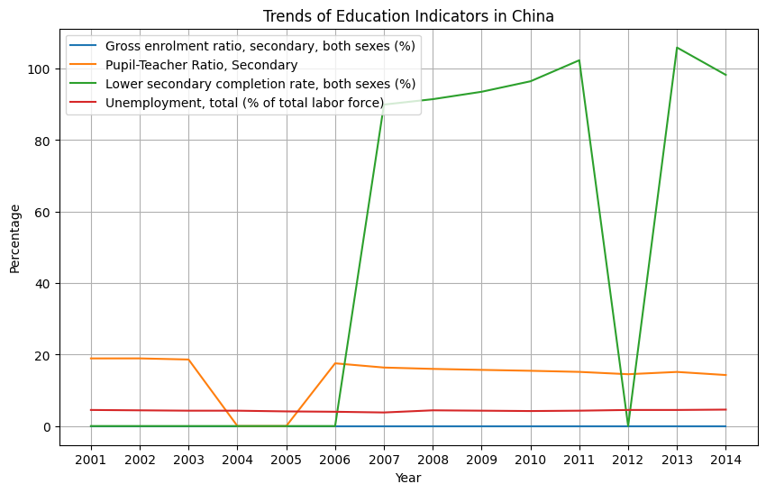
Data Visualization
Problem Statement 1: extract the data of all the seven indicators of china and store in one variable
Pupil-teacher ratio in secondary education shows a decreasing trend from 2001 to 2006, followed by stable values until 2010. No data available after 2010.
Unemployment rate varies between 3.8% and 4.6%, with a missing value for 2017 (indicated as 0.0%).
Gross enrolment ratio in secondary education shows varying values, but with missing data indicated by 0.0% for some years.
The lower secondary completion rate increased from 89.93% in 2007 to 105.89% in 2013, suggesting an improvement in the rate of students completing lower secondary education.

Slide 16
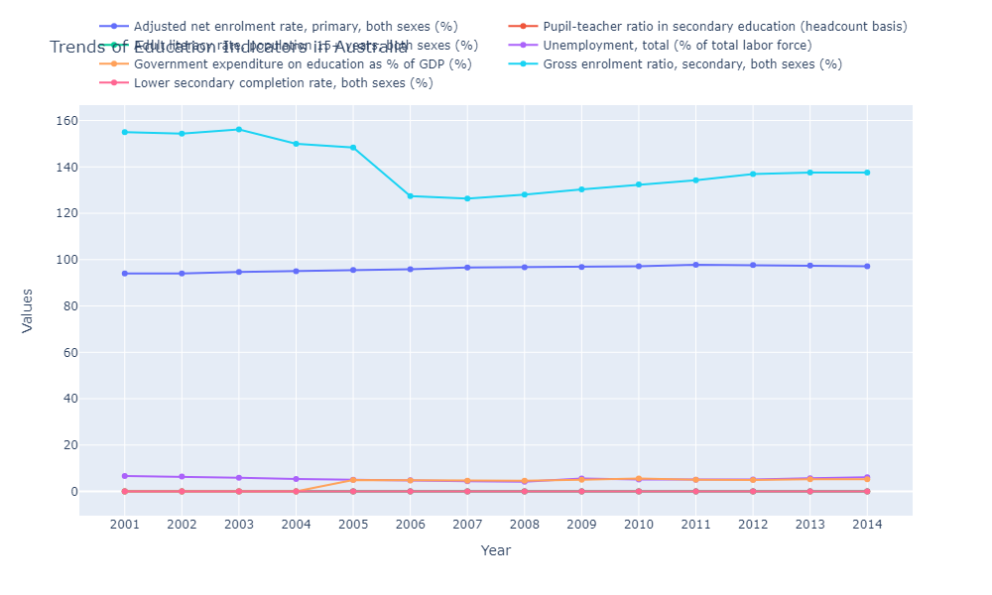
Data Visualization
Problem Statement :extract the data of all the seven indicators of France and store in one variable
Adult literacy rate, population 15+ years, both sexes (%): The dataset indicates that the adult literacy rate for the population aged 15 years and above is consistently reported as 0.0%. However, it is important to note that this value seems unrealistic or missing in the dataset provided.
Unemployment, total (% of total labor force): The unemployment rate shows some variation over the years, ranging from 7.5% to 10.4%. Higher unemployment rates may indicate challenges in the labor market and potential socioeconomic implications.
Government expenditure on education as % of GDP (%): The dataset shows a consistent value of 5.4% to 5.7% for government expenditure on education as a percentage of GDP. This indicates a relatively stable commitment to investing in education.
Gross enrolment ratio, secondary, both sexes (%): The gross enrolment ratio for secondary education shows a gradual increase over the years, ranging from 107.9% to 112.3%. This suggests an increasing participation rate in secondary education.
Lower secondary completion rate, both sexes (%): The lower secondary completion rate shows a generally high value, ranging from 95.5% to 103.8%. This indicates a relatively high rate of completion of lower secondary education by both sexes.
Adjusted net enrolment rate, primary, both sexes (%): The adjusted net enrolment rate for primary education shows a consistently high value throughout the years, ranging from 98.9% to 99.6%. This indicates a high level of participation in primary education by both sexes.
Pupil-teacher ratio in secondary education (headcount basis): The pupil-teacher ratio in secondary education shows a slight fluctuation but remains relatively stable over the years, ranging from 11.4 to 12.8. This suggests a reasonably balanced student-to-teacher ratio in secondary education.

Slide 17
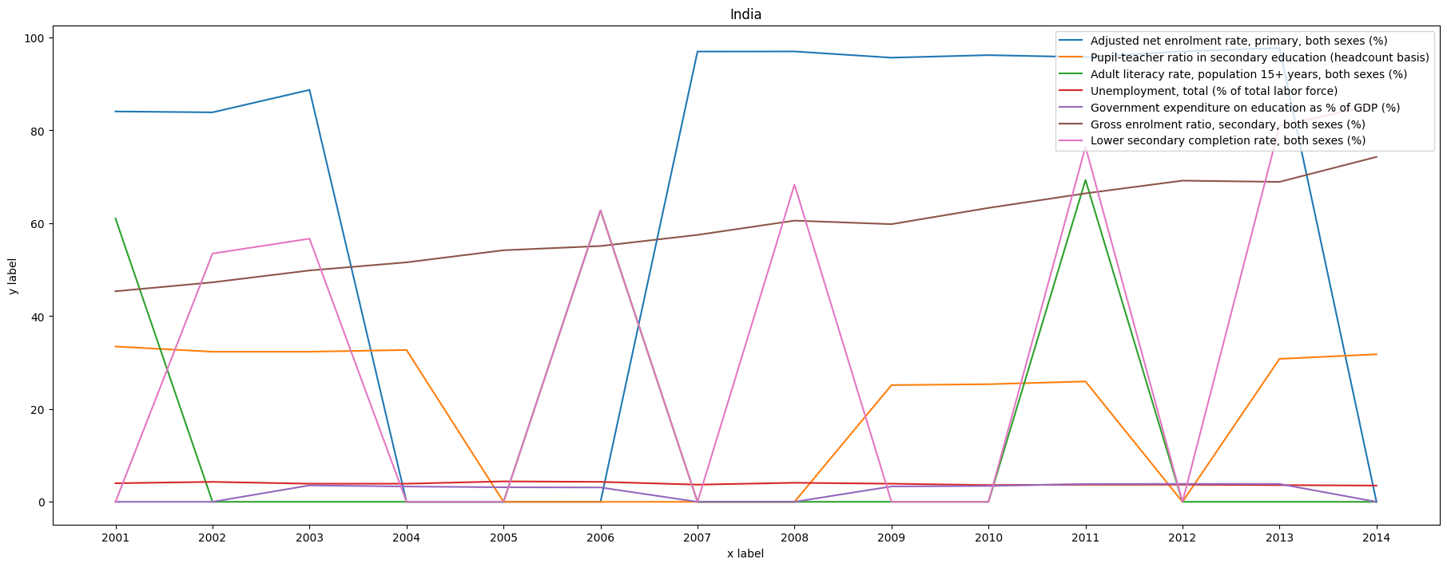
Data Visualization
Problem Statement 3: extract the data of all the seven indicators of India and store in one variable.
Unemployment, total (% of total labor force): The unemployment rate remains relatively stable over the years, ranging from 3.5% to 4.4%. Analyzing the reasons behind any significant changes in unemployment rate can provide valuable insights into the labor market dynamics.
Government expenditure on education as % of GDP (%): The dataset indicates a lack of information on government expenditure on education. This information is crucial for understanding the investment in education and its potential impact on the education system and outcomes.
Gross enrolment ratio, secondary, both sexes (%): The gross enrolment ratio in secondary education shows an increasing trend over the years, indicating a growing participation rate in secondary education. However, it is important to examine the quality of education and the transition rates from primary to secondary education.
Lower secondary completion rate, both sexes (%): The dataset shows gaps in lower secondary completion rate information, with some years reporting a value of 0.0. Further data is needed to assess the completion rate and its trend over time.
Adjusted net enrolment rate, primary, both sexes (%): The primary school enrolment rate shows a fluctuating trend over the years, with some years experiencing a decline. It is important to analyze the reasons behind these fluctuations to understand the factors affecting primary school enrolment.
Pupil-teacher ratio in secondary education (headcount basis): The pupil-teacher ratio in secondary education remains relatively stable over the years, indicating a consistent level of teacher availability in relation to the number of students. However, further analysis is required to assess the quality of education provided and the impact of the teacher-student ratio on learning outcomes.
Adult literacy rate, population 15+ years, both sexes (%): The dataset shows gaps in adult literacy rate information, with some years reporting a value of 0.0. Further data is needed to understand the adult literacy rate and its trend over time.

Slide 18
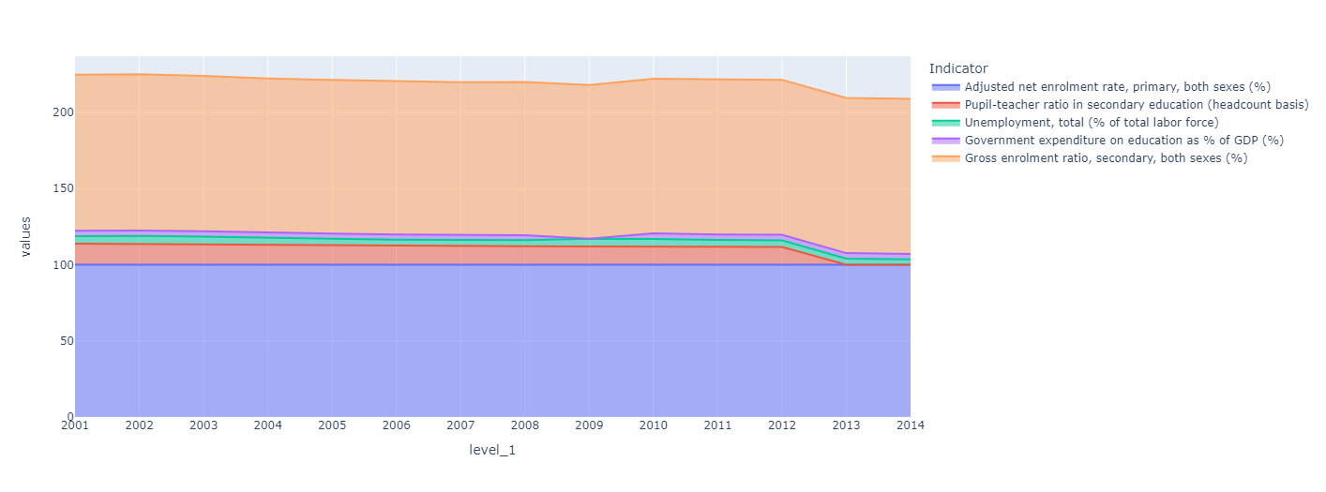
Data Visualization
Problem Statement 4: extract the data of all the seven indicators of Japan and store in one variable.
Adjusted net enrolment rate, primary, both sexes (%): The adjusted net enrolment rate in primary education is consistently high throughout the years, indicating a high level of participation and access to primary education for both sexes.
Pupil-teacher ratio in secondary education (headcount basis): The pupil-teacher ratio in secondary education is generally low, indicating a relatively favorable student-to-teacher ratio. This suggests that there may be sufficient resources and attention available to students in secondary education.
Unemployment, total (% of total labor force): The unemployment rate has varied over the years, with fluctuations in the percentage of the total labor force that is unemployed. Further analysis would be required to determine specific trends and factors influencing these variations.
Government expenditure on education as % of GDP (%): The dataset shows varying levels of government expenditure on education as a percentage of GDP. This indicates the allocation of financial resources by the government towards the education sector. Higher percentages suggest a greater commitment to investing in education.
Gross enrolment ratio, secondary, both sexes (%): The gross enrolment ratio in secondary education is relatively high, indicating a significant proportion of the population enrolling in secondary education. This suggests a positive trend in access to secondary education for both sexes.

Slide 19
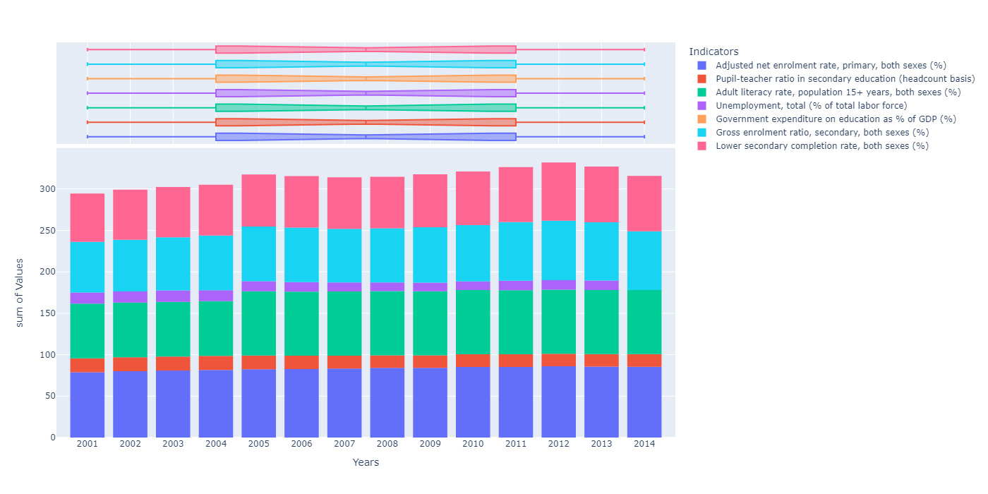
Data Visualization
Problem Statement 5:extract the data of all the seven indicators of Switzerland and store in one variable.
of literacy among the population aged 15 years and above.
Unemployment, total (% of total labor force): The unemployment rate has shown fluctuations over the years, with a peak in 2001 and a decrease in subsequent years. However, it's important to note that the dataset provided does not contain values for the years 2015, 2016, and 2017.
Government expenditure on education as % of GDP (%): The government expenditure on education as a percentage of GDP is reported as 0.0% for all years in the dataset. This suggests that there is no government expenditure on education recorded, which may have implications for the funding and support of the education sector.
Gross enrolment ratio, secondary, both sexes (%): The gross enrolment ratio for secondary education has been increasing steadily, indicating an overall improvement in access to secondary education for both sexes.
Lower secondary completion rate, both sexes (%): The lower secondary completion rate has shown an upward trend over the years, suggesting an improvement in the proportion of students completing lower secondary education.
Adjusted net enrolment rate, primary, both sexes (%): The primary school enrolment rate has been increasing over the years, indicating improved access to primary education for both sexes.
Pupil-teacher ratio in secondary education (headcount basis): The pupil-teacher ratio in secondary education has been decreasing, suggesting a better student-teacher ratio and potentially improved quality of education.
Adult literacy rate, population 15+ years, both sexes (%): The adult literacy rate has remained relatively constant at 77.36%, indicating a consistent level

Slide 20
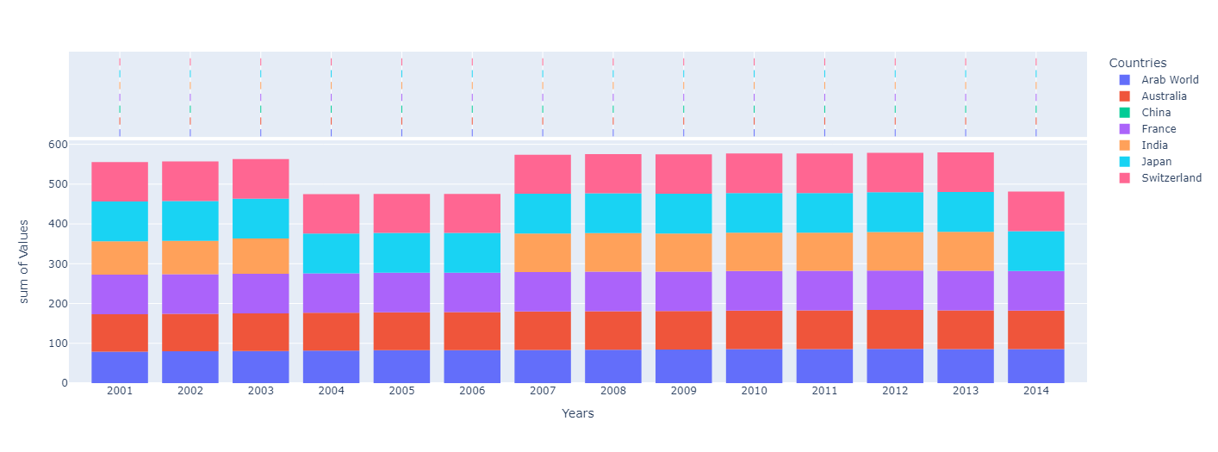
Data Visualization level 2
Problem Statement 5: extract the data of Adjusted net enrolment rate, primary, both sexes (%)
France: France has consistently achieved a high adjusted net enrollment rate for primary education, ranging from 99% to 99.4%. This demonstrates a strong commitment to ensuring primary education for both sexes.
India: India's adjusted net enrollment rate for primary education has varied over the years, ranging from 83.9% to 97.7%. The data suggests some fluctuations in enrollment rates, indicating potential challenges in ensuring universal primary education.
Japan: Japan has consistently maintained a high adjusted net enrollment rate for primary education, with rates above 99% throughout the available years. This highlights Japan's success in ensuring primary education for both sexes.ice calls churn more than four times as often as do the other customers
Arab World: The adjusted net enrollment rate for primary education in the Arab World has shown a steady increase over the years. It started at 78.8% in 2001 and reached 85.3% in 2014. However, there is no data available for 2015, 2016, and 2017.
Australia: Australia has consistently maintained a high adjusted net enrollment rate for primary education throughout the available years, ranging from 94% to 97.8%. This indicates a strong focus on ensuring primary education for both sexes.
China: The data shows that there is no available information for China's adjusted net enrollment rate for primary education. This could be due to missing data or unavailability in the database.

Slide 21
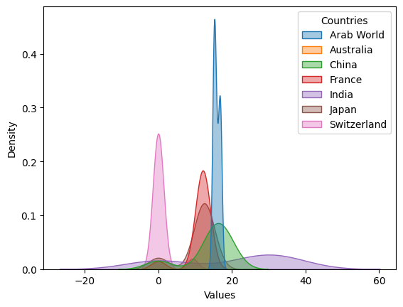
Data Visualization
Problem 6: extract the data of Pupil-teacher ratio in secondary education (headcount basis) of all countries
China: The pupil-teacher ratio in secondary education decreased from 18.92 in 2001 to 13.82 in 2014, indicating a significant improvement in teacher-student ratios.
France: The pupil-teacher ratio in secondary education decreased from 11.61 in 2001 to 12.83 in 2012. After 2012, there is no data available as the values are zeros.
India: The pupil-teacher ratio in secondary education decreased from 33.44 in 2001 to 30.78 in 2013, showing a gradual improvement in teacher-student ratios.
Japan: The pupil-teacher ratio in secondary education decreased from 13.83 in 2001 to 11.68 in 2012, indicating an improvement in teacher-student ratios. However, from 2013 onwards, there is no data available.
Switzerland: The data shows no pupil-teacher ratio for secondary education in Switzerland from 2001 to 2014 as the values remain consistently at 0.0.
Arab World: The pupil-teacher ratio in secondary education decreased from 16.70 in 2001 to 15.10 in 2013, indicating an improvement in teacher-student ratios. However, from 2013 onwards, the data shows zeros, which might indicate missing or incomplete data.
Australia: The data shows no pupil-teacher ratio for secondary education in Australia from 2001 to 2014 as the values remain consistently at 0.0.

Slide 22
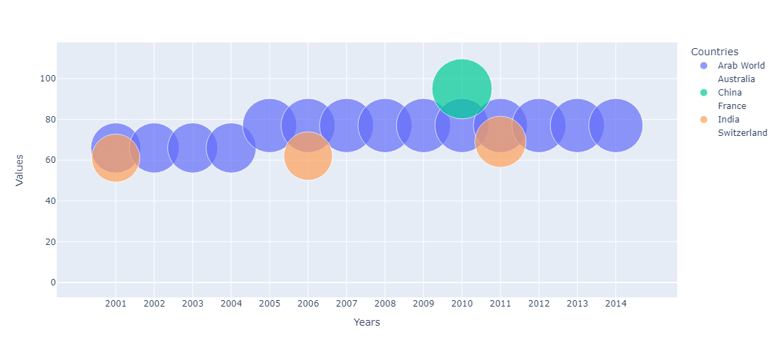
Data Visualization
Problem 7: extract the data of Adult literacy rate, population 15+ years, both sexes (%) of all countries
in 2001, reached 69.30% in 2011, and remained at that level until 2014. However, the data is missing for the years before 2001 and after 2014.
Japan: The data suggests a consistent value of 0.0% for Japan throughout the years, indicating that the specific data for this indicator is missing or unavailable.
Switzerland: Similar to Japan, the data shows a consistent value of 0.0% for Switzerland, suggesting that the adult literacy rate for both sexes was not provided or available in the dataset.
Arab World: The adult literacy rate in the Arab World remained relatively stable over the years, with a consistent value of 77.36% from 2005 to 2014. However, the data is missing or unavailable for the years before 2005 and after 2014, making it difficult to determine the overall trend.
Australia: The data indicates a literacy rate of 0.0% for Australia throughout the years, suggesting that the specific data for this indicator is missing or unavailable.
China: The data shows a consistent value of 0.0% for China, indicating that the adult literacy rate for both sexes was not provided or available in the dataset.
France: Similar to China, the data shows a consistent value of 0.0% for France, suggesting that the adult literacy rate for both sexes was not provided or available in the dataset.
India: The data indicates a gradual increase in the adult literacy rate for India. It started at 61.01%

Slide 23
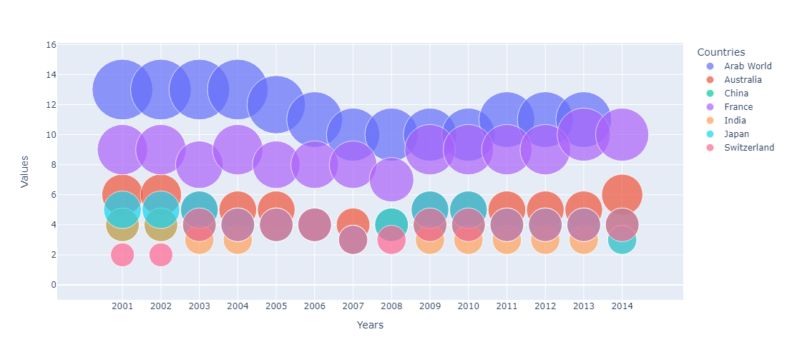
Data Visualization
Problem Statement 7: extract the data of Unemployment, total (% of total labor force) of all countries
France: France has experienced varying total unemployment rates over the available years. The rates range from a low of 7.5% in 2008 to a high of 10.4% in 2015. This suggests fluctuations in the labor market and potential challenges in maintaining stable employment rates.
India: The data shows that India's total unemployment rates have remained relatively low throughout the available years. The rates range from 3.5% in 2014 to 4.4% in 2013. This indicates a relatively stable employment situation in India during the specified period.
Japan: The dataset does not include any information on Japan's total unemployment rate. Therefore, no insights can be derived for Japan from this particular dataset.
Switzerland: The data reveals that Switzerland has maintained consistently low total unemployment rates over the available years. The rates range from 3.1% in 2016 to 4.6% in 2014. This indicates a generally low level of unemployment in Switzerland.
.
Arab World: The data shows that the Arab World has experienced fluctuating total unemployment rates over the available years. The rates range from a high of 13.4% in 2001 to a low of 10.4% in 2011.
Australia: Australia has consistently maintained relatively low total unemployment rates throughout the available years. The rates range from 4.2% in 2008 to 6.7% in 2001. This indicates a generally stable and low level of unemployment in the country.
China: The dataset does not provide any information on China's total unemployment rate. Therefore, no insights can be derived for China from this particular dataset.

Slide 24
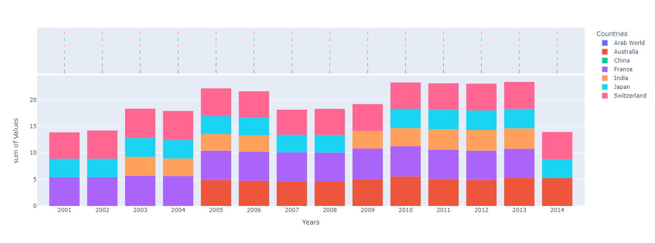
Data Visualization
Problem Statement 8: extract the data of Government expenditure on education as % of GDP (%) of all countries
Therefore, no insights can be derived for China from this particular dataset.
France: The data shows that France has allocated a certain portion of its GDP to government expenditure on education. However, the specific percentages are not provided in the dataset, limiting the ability to analyze the trend or compare it with other countries.
India: The dataset does not include any information on government expenditure on education as a percentage of GDP for India. Therefore, no insights can be derived for India from this particular dataset.
Japan: The data does not provide any information on government expenditure on education as a percentage of GDP for Japan. Therefore, no insights can be derived for Japan from this particular dataset.
Switzerland: The dataset does not include any information on government expenditure on education as a percentage of GDP for Switzerland. Therefore, no insights can be derived for Switzerland from this particular dataset.
It's important to note that the insights are limited due to the lack of specific data in the provided dataset. To gain a more comprehensive understanding of government expenditure on education, additional data and analysis are required.
Arab World: The dataset does not include any information on government expenditure on education as a percentage of GDP for the Arab World. Therefore, no insights can be derived for the Arab World from this particular dataset.
Australia: The data indicates that Australia has consistently allocated a certain portion of its GDP to government expenditure on education over the available years. However, the specific percentages are not provided in the dataset, making it difficult to determine the exact level of investment in education.
China: The dataset does not provide any information on government expenditure on education as a percentage of GDP for China.

Slide 25
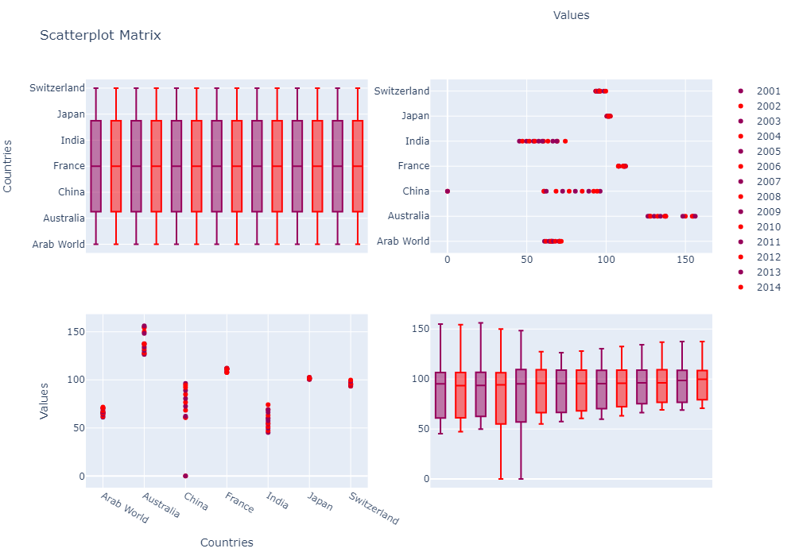
Data Visualization
Problem Statement 9: extract the data of Gross enrolment ratio, secondary, both sexes (%) of all countries
Disparities between Countries:
There are significant variations in gross enrolment ratios between countries. Some countries consistently maintain high enrolment ratios, while others have lower ratios. Australia, Switzerland, and Japan consistently show relatively high gross enrolment ratios, indicating a higher proportion of secondary school-age children enrolled in those countries. China and India, despite their large populations, show relatively lower enrolment ratios compared to other countries in the dataset.
Time Periods: The dataset contains missing values for some countries in certain years, particularly after 2015. This limits the analysis of recent trends. Further analysis of more recent data would provide a more comprehensive understanding of the enrolment ratios and any emerging patterns or changes over time.
Policy Implications: Countries with lower enrolment ratios may need to focus on improving access to and quality of secondary education to ensure more students have the opportunity to continue their education beyond primary level. Countries with consistently high enrolment ratios may need to prioritize maintaining the quality of education and addressing issues related to equity and inclusiveness.
Overall Trends: The gross enrolment ratio for secondary education generally increased over the years in most countries. Some countries experienced fluctuations or stagnation in certain periods, but the overall trend shows an upward trajectory.

Slide 26
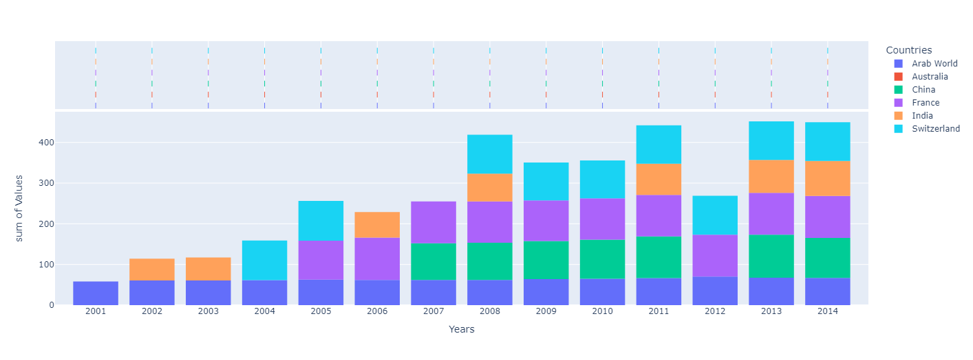
Data Visualization
Problem Statement 10: extract the data of Lower secondary completion rate, both sexes (%) of all countries
completion rate starting at 0.0% in 2001 and reaching 103.39% in 2014. As with China, values above 100% suggest the presence of students repeating grades or joining lower secondary education at a later age.
India: The lower secondary completion rate in India has varied over the years. The data shows an increase from 0.0% in 2001 to 85.63% in 2014, but it is not provided for other years. This indicates progress in improving the completion rate, but the missing data makes it difficult to analyze the overall trend.
Japan: The data suggests that Japan had a consistent lower secondary completion rate of 0.0% throughout the years, indicating that the specific data for this indicator is missing or unavailable.
Switzerland: The data shows an increasing trend for Switzerland, starting from 0.0% in 2001 and reaching 96.75% in 2015. However, no data is available for the years after 2015, making it challenging to determine the trend beyond that point.
Arab World: The lower secondary completion rate in the Arab World has generally increased over the years, starting at 58.28% in 2001 and reaching 70.29% in 2012. However, the data is missing for the years 2015, 2016, and 2017, making it difficult to determine the trend beyond 2014.
Australia: The data shows a consistent value of 0.0% for Australia throughout the years, indicating that the completion rate for lower secondary education was not provided or available in the dataset.
China: The data indicates that China had a gradual increase in the lower secondary completion rate, starting from 0.0% in 2001 and reaching 105.89% in 2013. It is important to note that a value above 100% suggests that there might be some students who are repeating grades or starting lower secondary education at a later age.
France: The data shows an increasing trend for France, with the lower secondary
Arab World: The lower secondary completion rate in the Arab World has generally increased over the years, starting at 58.28% in 2001 and reaching 70.29% in 2012. However, the data is missing for the years 2015, 2016, and 2017, making it difficult to determine the trend beyond 2014.
Australia: The data shows a consistent value of 0.0% for Australia throughout the years, indicating that the completion rate for lower secondary education was not provided or available in the dataset.
China: The data indicates that China had a gradual increase in the lower secondary completion rate, starting from 0.0% in 2001 and reaching 105.89% in 2013. It is important to note that a value above 100% suggests that there might be some students who are repeating grades or starting lower secondary education at a later age.
France: The data shows an increasing trend for France, with the lower secondary

Slide 27
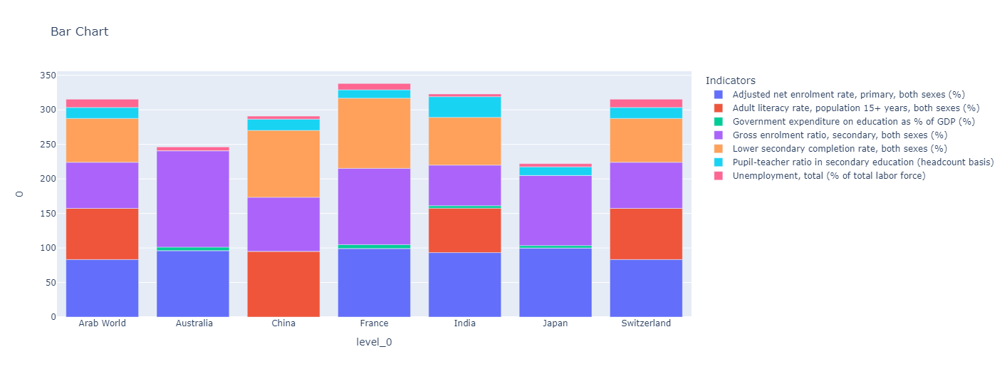
Data Visualization level 3
Problem Statement 12: a basic trend follow through would be performed basically we extract the data of different countries with same seven indicators so we can compare them to each other to improve the education quality
Government Expenditure on Education: Australia allocates 5.0% of its GDP to education, suggesting a relatively high investment in the education sector. India allocates 3.5% of its GDP to education, indicating a moderate level of investment in education. Some countries, such as Arab World and Switzerland, have missing or unavailable data for government expenditure on education as a percentage of GDP.
Secondary Education: Australia has a high gross enrolment ratio in secondary education (139.6%), suggesting a high proportion of secondary school-age students are enrolled. India has a relatively low gross enrolment ratio in secondary education (59.8%), indicating a need to improve access to and enrollment in secondary schools.
Other Factors: The dataset also includes indicators such as lower secondary completion rate and unemployment rates, which provide additional insights into the education and labor market situations across the countries.
Education Enrollment:Australia has a high adjusted net enrolment rate in primary education (96.2%), indicating a high percentage of children attending primary school. Japan has a very high adjusted net enrolment rate in primary education (99.97%), indicating near-universal enrollment in primary schools. China has missing or unavailable data for adjusted net enrolment rate in primary education, indicating a lack of information.
Literacy Rates: China has a relatively high adult literacy rate (95.1%), indicating a significant portion of the population aged 15 years and above can read and write. India has a lower adult literacy rate (64.4%), indicating a need for further efforts to improve literacy levels.

Slide 28

Key Insights
The Final Key Values of the specific indicators respected to their Countries. This chart shows the present context of the countries.

Slide 29
Key Insights
Education Disparities: There are significant disparities in education indicators across the countries. While some countries have high enrolment rates, completion rates, and literacy rates, others are lagging behind.
Government Investment: Government expenditure on education plays a crucial role in improving educational outcomes. Countries with higher investment tend to have better enrolment rates and educational attainment.
Improving Enrolment: Increasing enrolment rates, especially at the primary and secondary levels, is essential to ensure that more children have access to education and can complete their studies.
Literacy Challenges: Adult literacy rates in some countries are relatively low, indicating the need for targeted adult literacy programs to enhance literacy levels among the adult population.
Employment Indicators: Unemployment rates vary across countries, with some countries experiencing higher levels of unemployment. Investing in vocational training and skill development can help address this issue.
Pupil-Teacher Ratio: The pupil-teacher ratio in secondary education impacts the quality of education. Lower ratios tend to be associated with better learning outcomes.
Success Stories: Some countries have made significant progress in education and employment indicators, providing valuable lessons and best practices for other nations to emulate.

Slide 30
Key Insights
Complexity of Challenges: Improving education and employment opportunities is a complex task that requires a multifaceted approach and collaboration between governments, educational institutions, and various stakeholders.
Long-Term Vision: Achieving the business objective of improving education and employment requires sustained efforts and a long-term vision to create lasting impact and positive change.
Context Matters: Each country has its unique socio-economic, cultural, and educational context. Tailored strategies and solutions are necessary to address the specific challenges faced by each nation.
Overall, the data highlights the importance of investing in education, addressing literacy challenges, promoting skill development, and learning from successful models to achieve the business objective of enhancing education and employment opportunities in the respective countries.

Slide 31
Solutions to Business objective
Increase Government Expenditure on Education: Countries with higher government expenditure on education as a percentage of GDP tend to have better educational outcomes. The client should advocate for increased investment in education to improve infrastructure, teacher training, and access to quality education.
Focus on Adult Literacy Programs: Adult literacy rates in some countries are relatively low. Implementing targeted adult literacy programs can help improve overall literacy rates and enhance the employability of the adult population.
Enhance Enrolment Rates at Primary and Secondary Levels: While some countries have high enrolment rates at primary and secondary levels, others lag behind. Implement policies and initiatives to increase enrolment rates to ensure more children have access to education.
Improve Lower Secondary Completion Rate: Some countries struggle with lower secondary completion rates. Targeted interventions and support systems should be put in place to ensure students successfully complete lower secondary education, as this is a critical phase in their educational journey.
Address Pupil-Teacher Ratio: Lower pupil-teacher ratios in secondary education are associated with better learning outcomes. Reducing class sizes or hiring more qualified teachers can improve the learning environment for students.
Promote Vocational and Skill Development: Countries with higher unemployment rates can benefit from investing in vocational and skill development programs. These initiatives can help equip individuals with the skills and training needed to enter the job market successfully.
Monitor and Learn from Successful Models: The client should closely study countries that have achieved significant progress in education and employment indicators to identify successful strategies that can be adapted and implemented in other countries.
Collaborate with International Organizations: Collaborating with international organizations and partners can provide additional resources, expertise, and best practices in the field of education and employment.
It is essential for the client to work closely with the respective governments, educational institutions, and stakeholders in each country to implement these strategies effectively and achieve their business objective of promoting better education and employment opportunities.

Slide 32
Conclusions
Diverse Trends: The indicators show diverse trends across different countries, with some indicators improving over time, while others experience fluctuations or decline.
Areas of Focus: To achieve the business objective, the client should focus on specific areas that require attention in each country. These areas may include increasing enrolment rates, improving completion rates, enhancing adult literacy, reducing unemployment, and addressing pupil-teacher ratios.
Investment in Education: Government expenditure on education is a crucial factor for better educational outcomes. Advocating for increased investment in education can lead to significant improvements in the quality and accessibility of education.
Leveraging Success Models: Learning from countries that have successfully improved their education and employment indicators can provide valuable insights for designing effective strategies and interventions.
Targeted Programs: Tailored programs for adult literacy, vocational training, and skill development can enhance employability and contribute to reducing unemployment rates.
Collaboration and Monitoring: Collaborating with international organizations and local stakeholders can foster the exchange of knowledge and resources, supporting the successful implementation of education and employment initiatives.
Long-term Perspective: Improving education and employment outcomes is a complex and long-term process that requires sustained efforts and dedication from all stakeholders involved.
In summary, by targeting specific indicators, investing in education, learning from successful models, and implementing targeted programs, the client can contribute to the improvement of education and employment opportunities in the respective countries. It is essential to work closely with governments and local communities to ensure the successful implementation of these initiatives and create a positive impact on the lives of individuals and communities.

Slide 33
Thank You!!
Education is the passport to the future, for tomorrow belongs to those who prepare for it today.

